Slide 2
Reference link
https://www.dj4e.com/assn/dj4e_autos.md?PHPSESSID=af97c59f6c715a35d6c988d181379175

Slide 3
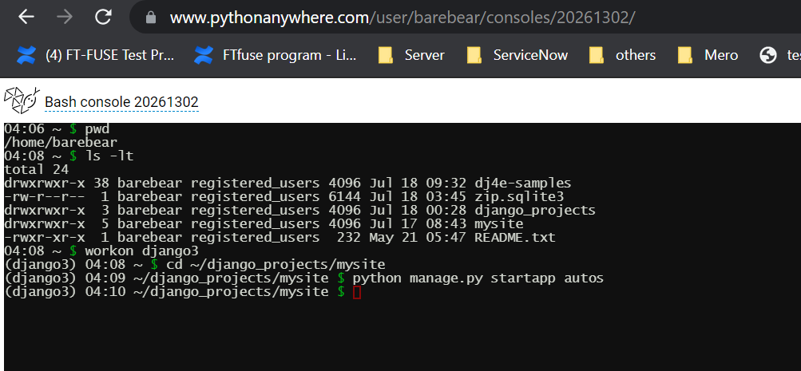
Create a new application

Slide 4
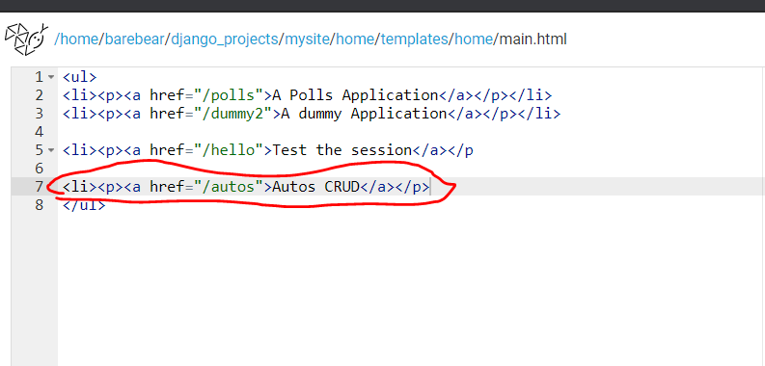
Update main.html

